Slide 1

Team Gradido

Slide 2


Slide 3


Communication - Tech via EMail
Detailed technical Discussions via EMail
Prone to produce misunderstandings & tension
Will never produce win/win situations - only win/lose situations
You are a team - if you don’t work as one you will not produce anything
Solution:
Use video conference & screensharing
Produce a document together outlining the solution (e.g. google docs / github)

Slide 4

Communication - English vs German
English is not very fluent with most of the team
English is the only way to communicate with Pauls
There is an aversion to use English
Pauls is shooed off to be able to switch back to German
Solution:
???
Learn English (?)

Slide 5
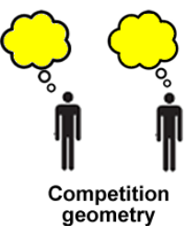
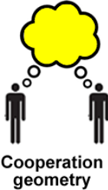
Competition - My concept vs Your concept
Struggle for superiority & ownership of a concept/implementation
Competition instead of Cooperation
The other is seen as the enemy
Solution:
Work as a Team
The goal can only be reached together
Communication is key

Slide 6
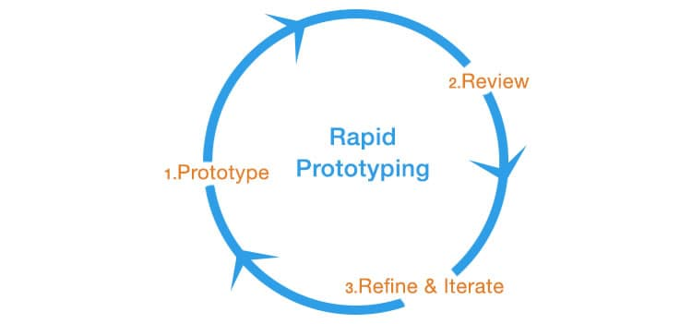
Far Future Perspective
Looking into the future “what if”
This is not prototyping
The produced Software is considered unchangeable and monolithic
Solution:
Prototyping -> Get it running, no matter how
Software can always be changed
KISS -> Keep It Simple Stupid
We develop a tool not a religion

Slide 7
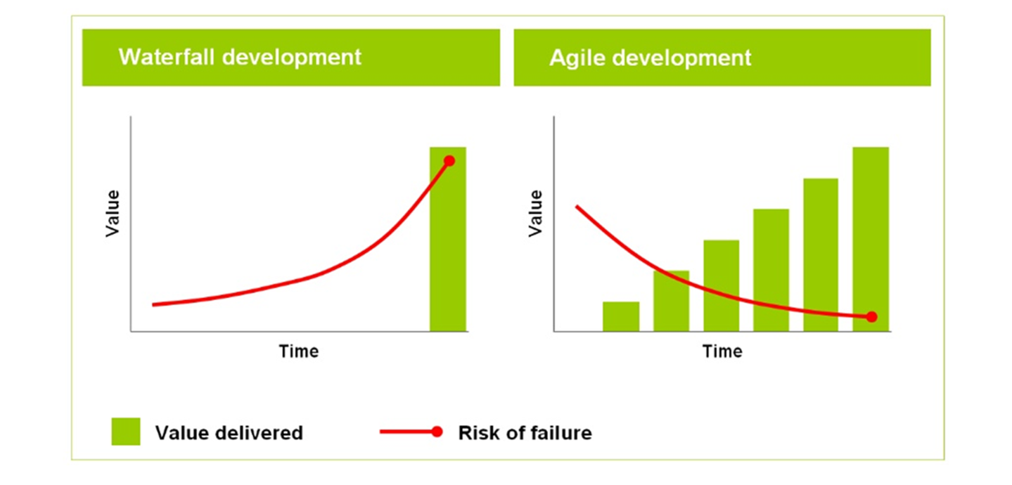
Waterfall instead of Agile Development

Slide 8
Why Blockchain?
Why use Blockchain?
What’s the Advantage?
What does it solve?
Does it outweigh the development costs?
Isn’t it too complicated?
Will we not just hide everything behind centralized servers anyway?
Federation instead of full decentralization?
Where is the advantage for the consumer?

Slide 9



Fear of BigTech, Government & Others
Fear of Microsoft & other big Techs
Fear of “them” shutting down Gradido
Fear of backdoors in Software
Why?
They only care for you if you are relevant
There is no secure software system ever, there is always an attack vector
Fear cripples everything
Solution:
Talk about your Fears and dismiss them
Do you really want to succeed with the project?
Focus on our Values, Mission and Vision

Slide 10

No clear goals & concepts (?)
Where is the central concept formalised in an implementation plan?
Software structure seems good (!)
Deployment structure seems not be present (?)
A lot of scattered & outdated documentation
Task:
What is the overall goal? Why are you doing what you are doing?
What are you doing now to achieve that goal?
Do the ends justify the means?

Slide 11


Slide 12
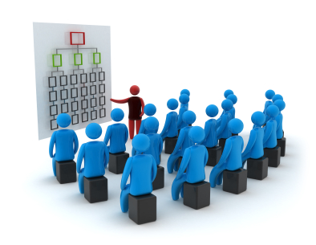
Centralize all Code in a visible space
including the systems currently live
Benefits:
Overview & Visual overview of code
Easy onboarding & advertisement for new Developers
Access for non-coders
Easy to go Open Source
What do the other Team members do?
It’s the standard nowadays
Solutions:
Github
Gitlab
Atlassian
Bitbucket

Slide 13
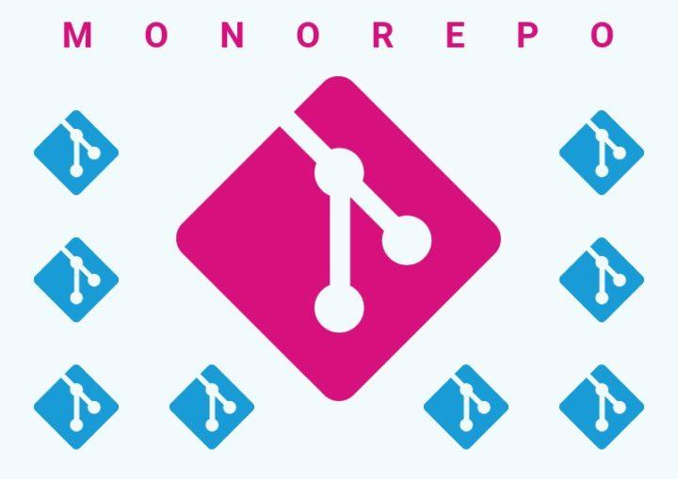
Combine Code & Docu
Combine all Repositories in one
Put in all Documentation as well
Benefits:
There is no need to have separate Repositories
It will enhance collaboration
It will increase efficiency
Will bring software together that belongs together
Enhances all aspects of inter-software functioning
Deployment on the horizon

Slide 14

Go Open Source
There is no disadvantages, only advantages
It’s aligned with the core values of Gradido
More people can see and join
The so called “Safe Space” is not needed - for what?

Slide 15

Solve the Team Problems
or we will not reach our Goals. All our work would go to waste.

Slide 16

We need a Development Plan
What are our next Goals?
How can we reach them?
How can we formalize and organize them?
How can we make sure stuff works?
How can we put our software in action as soon as possible?
Solution:
CI (Continuous Integration)
Develop & Transform the live Systems
Github, Issues & Zenhub

Slide 17
Values, Mission & Vision
We need to define this!
Homework:
What are your Values?
What is your Mission?
What is your Vision?
What are Gradidos Values?
What is Gradidos Mission?
What is Gradidos Vision?

